Slide 1
SASBITreeViewer
Install & Configuration Guide
2014.08

Slide 2

Table of contents
1. Introduction
2. Installation
3. Create report
4. Contact Info.

Slide 3
1.iNTRODUCTION
.
This document covers how to install SASBITreeViewer which is fully integrated with SAS Portal and create SASBITreeViewer report.
Background
To meet clients needs for typical reports.
Only need SAS programming (No other 3rd party programming is required)
Easy to apply design(CSS)

Slide 4
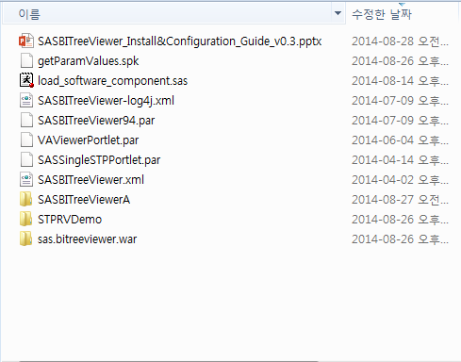
2.INSTALLATION
Required files
All source codes are provided.
Please make sure you have all files and folders on hand.

Slide 5
2.INSTALLATION
Copy sas.bitreeviewer.war
Copy ‘sas.bitreeviewer.war’ to ‘C:\SAS\Config\Lev1\Web\WebAppServer\SASServer1_1\sas_webapps\’

Slide 6
2.INSTALLATION
Add SASBITreeViewer.xml
Add ‘SASBITreeViewer.xml’ to ‘C:\SAS\Config\Lev1\Web\WebAppServer\SASServer1_1\conf\Catalina\localhost\’

Slide 7
2.INSTALLATION
Add SASBITreeViewer-log4j.xml
Add ‘SASBITreeViewer-log4j.xml’ to ‘C:\SAS\Config\Lev1\Web\Common\LogConfig\’

Slide 8
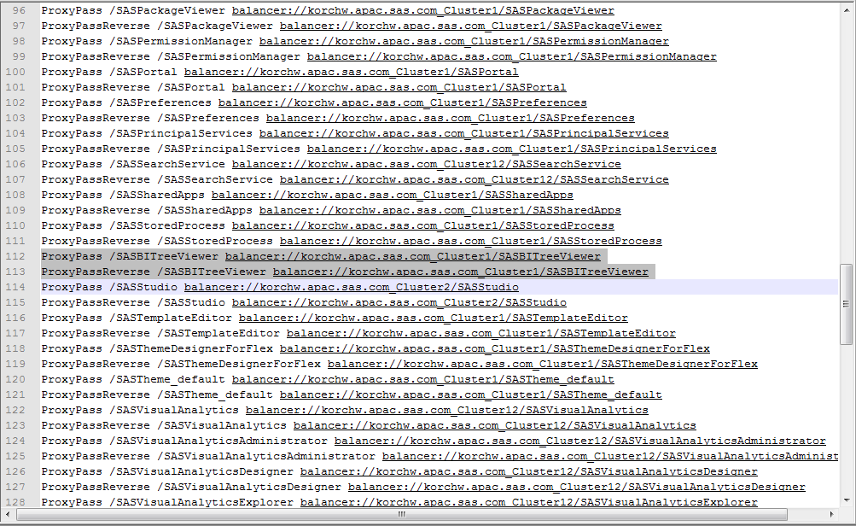
2.INSTALLATION
Edit sas.conf
Add below 2 lines in ‘C:\SAS\Config\Lev1\Web\WebServer\conf\sas.conf’
ProxyPass /SASBITreeViewer balancer://korchw.apac.sas.com_Cluster1/SASBITreeViewer
ProxyPassReverse /SASBITreeViewer balancer://korchw.apac.sas.com_Cluster1/SASBITreeViewer

Slide 9
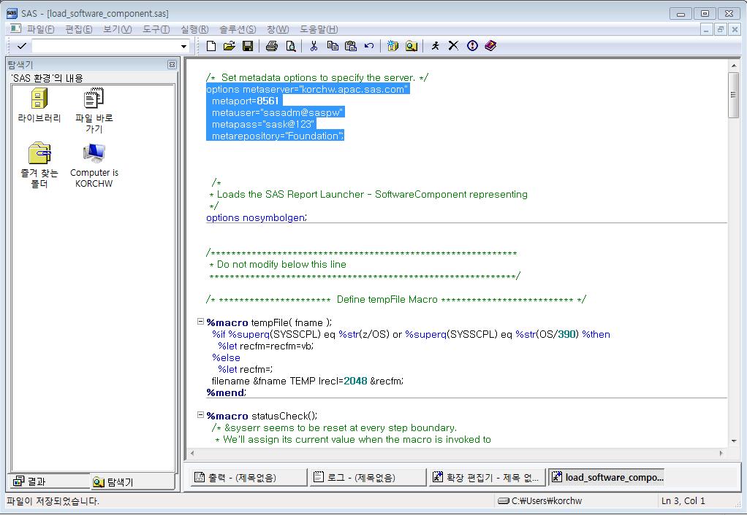
2.INSTALLATION
Register SASBitreeviewer in metadata
Open ‘load_software_component.sas’
Edit red highlighted color code in accordance with your environment.
options metaserver="korchw.apac.sas.com"
metaport=8561
metauser=“sasadm@saspw"
metapass=“sask@123"
metarepository="Foundation";
* Full source codes are on the notes
Notes:
/* Set metadata options to specify the server. */
options metaserver="korchw.apac.sas.com"
metaport=8561
metauser="sasadm@saspw"
metapass="SASk@123"
metarepository="Foundation";
/*
* Loads the SAS Report Launcher - SoftwareComponent representing
*/
options nosymbolgen;
/************************************************************
* Do not modify below this line
************************************************************/
/* ********************** Define tempFile Macro ************************** */
%macro tempFile( fname );
%if %superq(SYSSCPL) eq %str(z/OS) or %superq(SYSSCPL) eq %str(OS/390) %then
%let recfm=recfm=vb;
%else
%let recfm=;
filename &fname TEMP lrecl=2048 &recfm;
%mend;
%macro statusCheck();
/* &syserr seems to be reset at every step boundary.
* We'll assign its current value when the macro is invoked to
* a global var named LOAD_STATUS. Then if LOAD_STATUS is ever FAILED,
* we can print a suitable message.
*/
%if &LOAD_STATUS ne ABORT %then %do;
*Assure that we never overwrite ABORT so that later statusChecks ;
* give GOOD in error.;
%if (&syserr ne 0 and &syserr ne 4) %then %let LOAD_STATUS = FAILED;
%else %let LOAD_STATUS = GOOD;
%end;
%mend statusCheck;
%global LOAD_STATUS;
%let LOAD_STATUS=GOOD;
%macro statusPrint;
data _null_;
/* Assure that errors print.
* Else, print success!
*/
%if &LOAD_STATUS = FAILED %then %do;
putlog "ERROR: An error occurred while loading metadata.";
%end;
%else %if &LOAD_STATUS = ABORT %then %do;
putlog "ERROR: Aborting because the metadata already exists!";
%end;
%else %do;
putlog "NOTE: Successfully loaded metadata.";
%end;
run;
%mend statusPrint;
/* Define macro to find metadata object IDs.
Parameters:
VARNAME - name of a macro variable that will be set to the object ID.
Set to blank if no matching object is found. Set to the
first matching object if more than one object is found.
OBJTYPE - An OMA type. For example, AuthenticationDomain or LogicalServer
SEARCH - An XMLSelect string defining the match criteria. For example,
@Name='My Object Name'.
Example:
%getMetadataID(DOMAIN_ID, AuthenticationDomain, @Name='sas.com');
finds an AuthenticationDomain named 'sas.com' and returns it in
the DOMAIN_ID global macro variable.
*/
%macro getMetadataID(VARNAME,OBJTYPE,SEARCH);
/* Build the GetMetadata request. */
%tempFile(request);
data _null_;
file request;
put "<GetMetadataObjects>";
put "<ReposId>$METAREPOSITORY</ReposId>";
put "<Type>&OBJTYPE</Type>";
put "<Objects/>";
put "<ns>SAS</ns>";
put "<Flags>128</Flags>";
put "<Options>";
put "%bquote(<XMLSelect search="&SEARCH"/>)";
put "</Options>";
put "</GetMetadataObjects>";
run;
/* Issue the request. */
%tempFile(response);
proc metadata
in=request
out=response;
run;
%if %eval(&SYSERR>4) %then %do;
%put ERROR: Failed to find metadata object;
%let LOAD_STATUS=FAILED;
%return;
%end;
/* Build the XML Map file to parse the response. */
%tempFile(map);
data _null_;
file map encoding="utf-8";
put '<?xml version="1.0" encoding="utf-8"?>';
put '<SXLEMAP version="1.0">';
put '<TABLE name="respid">';
put "<TABLE_XPATH>//&OBJTYPE.</TABLE_XPATH>";
put '<COLUMN name="Id">';
put "<XPATH>//&OBJTYPE.@Id</XPATH>";
put '<TYPE>character</TYPE>';
put '<DATATYPE>STRING</DATATYPE>';
put '<LENGTH>17</LENGTH>';
put '</COLUMN>';
put '</TABLE>';
put '</SXLEMAP>';
run;
/* Parse the response with the XML library engine and PROC SQL. */
libname response xml xmlmap=map;
%global &VARNAME;
%let &VARNAME=;
%local NOBS;
proc sql noprint ;
select Id, count(Id)
into :&VARNAME, :NOBS
from response.respid;
quit;
/* Cleanup.
filename request;
filename response;
filename map;
libname response;
*/
%put;
%if %superq(&VARNAME) eq %then
%put WARNING: Unable to find &OBJTYPE matching "&SEARCH";
%else %if %eval(&NOBS) gt 1 %then
%put NOTE: Found %cmpres(&NOBS) matching &OBJTYPE.s. Using first object %superq(&VARNAME);
%else
%put NOTE: Found &OBJTYPE %superq(&VARNAME);
%mend;
%macro getMeta;
/* Check if the pref connection already exists. If so, abort. Otherwise,
* a "duplicate" connection would be created.
*/
%getMetadataID(WIP_TREE, SoftwareComponent, @Name='SAS Application Infrastructure');
%put &WIP_TREE;
%getMetadataID(Pref_SWC, SoftwareComponent, @Name='SASBITreeViewer');
%if &Pref_SWC ne %then %do;
%put "ERROR: Aborting because the SAS BI Tree Viewer SoftwareComponent already exists!";
%let LOAD_STATUS=ABORT;
%return;
%end;
%else %put "NOTE: Creating SAS BI Tree Viewer SoftwareComponent.";
%mend getMeta;
%getMeta;
/* Output the XML for this theme connection */
%tempFile(tempxml);
options nocardimage;
data _null_;
file tempxml;
length long $256;
input;
long = _infile_;
long = tranwrd(long, '$WIP_TREE', "&WIP_TREE");
long = trim(long);
put long ' ';
cards4;
<AddMetadata>
<Metadata>
<SoftwareComponent Desc="SASBITreeViewer"
Major="9" Minor="3" Name="SASBITreeViewer"
ProductName="SASBITreeViewer" PublicType="Application"
SoftwareVersion="1.0" SpecVersion="1.0"
UsageVersion="1000000" TLObjN="1">
<DeployedComponents>
<DeployedComponent Name="Registered SAS Application">
<SourceConnections>
<TCPIPConnection Name="Connection URI"
CommunicationProtocol="http"
Desc="The URL to the root context of the preferences WAR"
HostName="korchw.apac.sas.com"
Port="80"
Service="/SASBITreeViewer"/>
</SourceConnections>
</DeployedComponent>
</DeployedComponents>
<ImplementedObjects>
<SoftwareComponent ObjRef="$WIP_TREE" />
</ImplementedObjects>
</SoftwareComponent>
</Metadata>
<Reposid>$METAREPOSITORY</Reposid>
<Ns>SAS</Ns>
<Flags>268435456</Flags>
<Options/>
</AddMetadata>
;;;;
run;
%macro loadMetadata;
%if &LOAD_STATUS ne GOOD %then %return;
/* Load the metadata. */
proc metadata
in=tempxml;
run;
quit;
%statusCheck;
%mend loadMetadata;
/* Load the metadata */
%loadMetadata;
/* Cleanup */
filename tempxml;
%statusPrint;

Slide 10
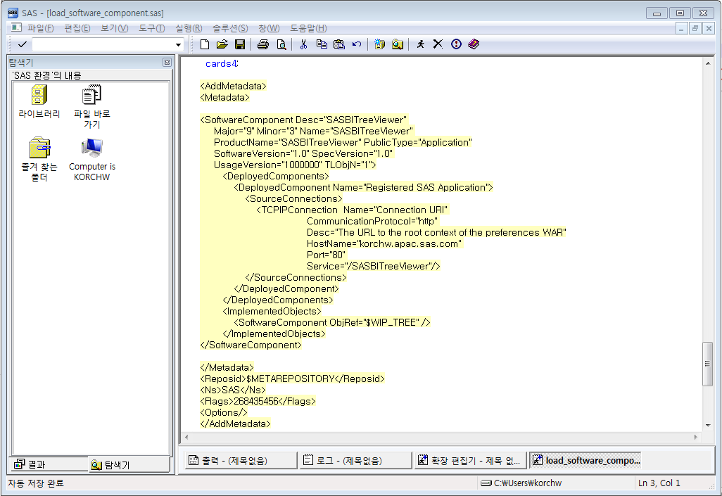
2.INSTALLATION
Register SASBitreeviewer in metadata
Open ‘load_software_component.sas’
Edit red highlighted color code in accordance with your environment.
<SourceConnections>
<TCPIPConnection Name="Connection URI"
CommunicationProtocol="http"
Desc="The URL to the root context of the preferences WAR"
HostName="korchw.apac.sas.com"
Port="80"
Service="/SASBITreeViewer"/>
</SourceConnections>
* Full source codes exist on the notes
Notes:
/* Set metadata options to specify the server. */
options metaserver="korchw.apac.sas.com"
metaport=8561
metauser="sasadm@saspw"
metapass="SASk@123"
metarepository="Foundation";
/*
* Loads the SAS Report Launcher - SoftwareComponent representing
*/
options nosymbolgen;
/************************************************************
* Do not modify below this line
************************************************************/
/* ********************** Define tempFile Macro ************************** */
%macro tempFile( fname );
%if %superq(SYSSCPL) eq %str(z/OS) or %superq(SYSSCPL) eq %str(OS/390) %then
%let recfm=recfm=vb;
%else
%let recfm=;
filename &fname TEMP lrecl=2048 &recfm;
%mend;
%macro statusCheck();
/* &syserr seems to be reset at every step boundary.
* We'll assign its current value when the macro is invoked to
* a global var named LOAD_STATUS. Then if LOAD_STATUS is ever FAILED,
* we can print a suitable message.
*/
%if &LOAD_STATUS ne ABORT %then %do;
*Assure that we never overwrite ABORT so that later statusChecks ;
* give GOOD in error.;
%if (&syserr ne 0 and &syserr ne 4) %then %let LOAD_STATUS = FAILED;
%else %let LOAD_STATUS = GOOD;
%end;
%mend statusCheck;
%global LOAD_STATUS;
%let LOAD_STATUS=GOOD;
%macro statusPrint;
data _null_;
/* Assure that errors print.
* Else, print success!
*/
%if &LOAD_STATUS = FAILED %then %do;
putlog "ERROR: An error occurred while loading metadata.";
%end;
%else %if &LOAD_STATUS = ABORT %then %do;
putlog "ERROR: Aborting because the metadata already exists!";
%end;
%else %do;
putlog "NOTE: Successfully loaded metadata.";
%end;
run;
%mend statusPrint;
/* Define macro to find metadata object IDs.
Parameters:
VARNAME - name of a macro variable that will be set to the object ID.
Set to blank if no matching object is found. Set to the
first matching object if more than one object is found.
OBJTYPE - An OMA type. For example, AuthenticationDomain or LogicalServer
SEARCH - An XMLSelect string defining the match criteria. For example,
@Name='My Object Name'.
Example:
%getMetadataID(DOMAIN_ID, AuthenticationDomain, @Name='sas.com');
finds an AuthenticationDomain named 'sas.com' and returns it in
the DOMAIN_ID global macro variable.
*/
%macro getMetadataID(VARNAME,OBJTYPE,SEARCH);
/* Build the GetMetadata request. */
%tempFile(request);
data _null_;
file request;
put "<GetMetadataObjects>";
put "<ReposId>$METAREPOSITORY</ReposId>";
put "<Type>&OBJTYPE</Type>";
put "<Objects/>";
put "<ns>SAS</ns>";
put "<Flags>128</Flags>";
put "<Options>";
put "%bquote(<XMLSelect search="&SEARCH"/>)";
put "</Options>";
put "</GetMetadataObjects>";
run;
/* Issue the request. */
%tempFile(response);
proc metadata
in=request
out=response;
run;
%if %eval(&SYSERR>4) %then %do;
%put ERROR: Failed to find metadata object;
%let LOAD_STATUS=FAILED;
%return;
%end;
/* Build the XML Map file to parse the response. */
%tempFile(map);
data _null_;
file map encoding="utf-8";
put '<?xml version="1.0" encoding="utf-8"?>';
put '<SXLEMAP version="1.0">';
put '<TABLE name="respid">';
put "<TABLE_XPATH>//&OBJTYPE.</TABLE_XPATH>";
put '<COLUMN name="Id">';
put "<XPATH>//&OBJTYPE.@Id</XPATH>";
put '<TYPE>character</TYPE>';
put '<DATATYPE>STRING</DATATYPE>';
put '<LENGTH>17</LENGTH>';
put '</COLUMN>';
put '</TABLE>';
put '</SXLEMAP>';
run;
/* Parse the response with the XML library engine and PROC SQL. */
libname response xml xmlmap=map;
%global &VARNAME;
%let &VARNAME=;
%local NOBS;
proc sql noprint ;
select Id, count(Id)
into :&VARNAME, :NOBS
from response.respid;
quit;
/* Cleanup.
filename request;
filename response;
filename map;
libname response;
*/
%put;
%if %superq(&VARNAME) eq %then
%put WARNING: Unable to find &OBJTYPE matching "&SEARCH";
%else %if %eval(&NOBS) gt 1 %then
%put NOTE: Found %cmpres(&NOBS) matching &OBJTYPE.s. Using first object %superq(&VARNAME);
%else
%put NOTE: Found &OBJTYPE %superq(&VARNAME);
%mend;
%macro getMeta;
/* Check if the pref connection already exists. If so, abort. Otherwise,
* a "duplicate" connection would be created.
*/
%getMetadataID(WIP_TREE, SoftwareComponent, @Name='SAS Application Infrastructure');
%put &WIP_TREE;
%getMetadataID(Pref_SWC, SoftwareComponent, @Name='SASBITreeViewer');
%if &Pref_SWC ne %then %do;
%put "ERROR: Aborting because the SAS BI Tree Viewer SoftwareComponent already exists!";
%let LOAD_STATUS=ABORT;
%return;
%end;
%else %put "NOTE: Creating SAS BI Tree Viewer SoftwareComponent.";
%mend getMeta;
%getMeta;
/* Output the XML for this theme connection */
%tempFile(tempxml);
options nocardimage;
data _null_;
file tempxml;
length long $256;
input;
long = _infile_;
long = tranwrd(long, '$WIP_TREE', "&WIP_TREE");
long = trim(long);
put long ' ';
cards4;
<AddMetadata>
<Metadata>
<SoftwareComponent Desc="SASBITreeViewer"
Major="9" Minor="3" Name="SASBITreeViewer"
ProductName="SASBITreeViewer" PublicType="Application"
SoftwareVersion="1.0" SpecVersion="1.0"
UsageVersion="1000000" TLObjN="1">
<DeployedComponents>
<DeployedComponent Name="Registered SAS Application">
<SourceConnections>
<TCPIPConnection Name="Connection URI"
CommunicationProtocol="http"
Desc="The URL to the root context of the preferences WAR"
HostName="korchw.apac.sas.com"
Port="80"
Service="/SASBITreeViewer"/>
</SourceConnections>
</DeployedComponent>
</DeployedComponents>
<ImplementedObjects>
<SoftwareComponent ObjRef="$WIP_TREE" />
</ImplementedObjects>
</SoftwareComponent>
</Metadata>
<Reposid>$METAREPOSITORY</Reposid>
<Ns>SAS</Ns>
<Flags>268435456</Flags>
<Options/>
</AddMetadata>
;;;;
run;
%macro loadMetadata;
%if &LOAD_STATUS ne GOOD %then %return;
/* Load the metadata. */
proc metadata
in=tempxml;
run;
quit;
%statusCheck;
%mend loadMetadata;
/* Load the metadata */
%loadMetadata;
/* Cleanup */
filename tempxml;
%statusPrint;

Slide 11
2.INSTALLATION
Register SASBitreeviewer in metadata
Run ‘load_software_component.sas’

Slide 12
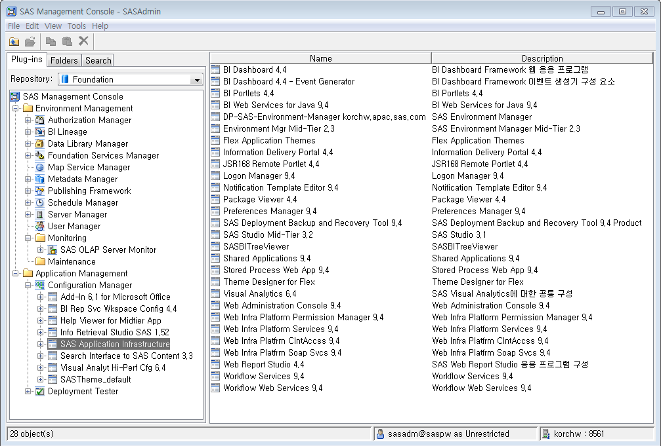
2.INSTALLATION
Register SASBitreeviewer in metadata
Log in SAS Management Console
Navigate to ‘Application Management’ -> ‘Configuration Manager’ -> Click to ‘SAS Application Infrastructure’
Check Whether ‘SASBITreeViewer’ exists or not

Slide 13
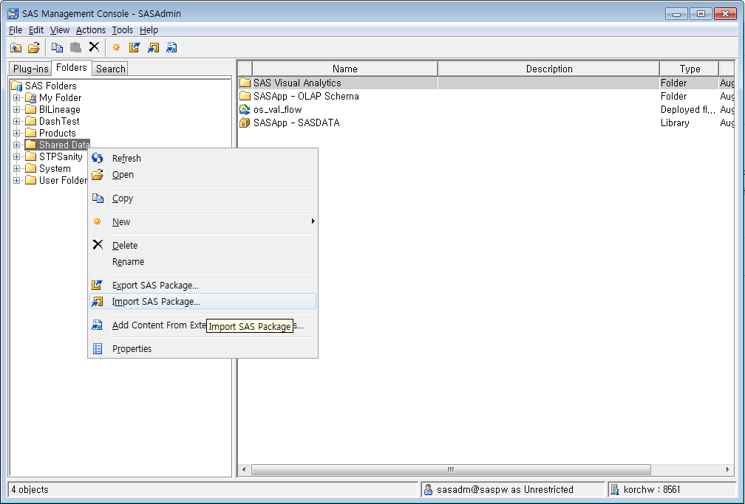
2.INSTALLATION
Import ‘getParamValues.spk’
Log in SAS Management Console
Click ‘Folders’ tab.
Right mouse click ‘Shared Data’
Click ‘Import SAS Package’

Slide 14
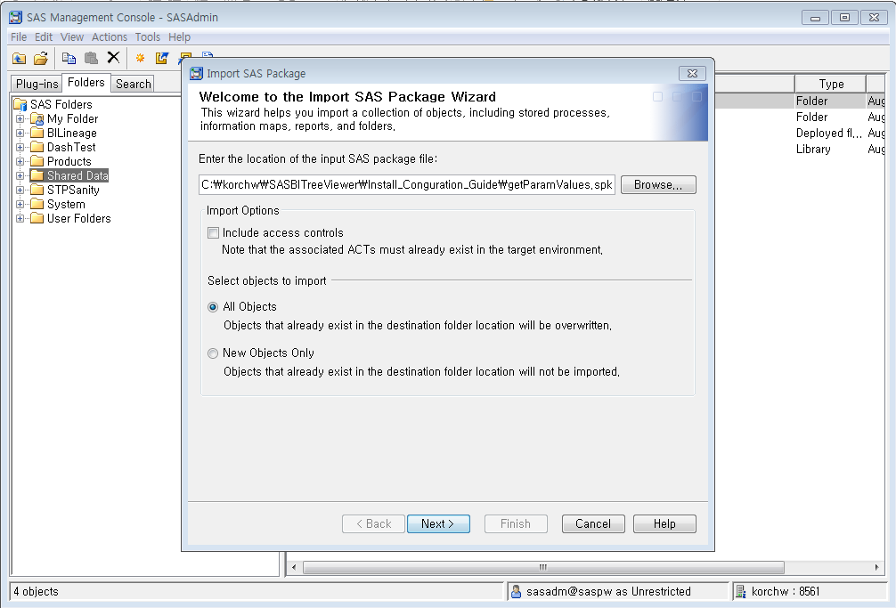
2.INSTALLATION
Import ‘getParamValues.spk’
1. Click ‘Browse’
5. Select ‘getParamValues.spk’
2. Click ‘Next’

Slide 15
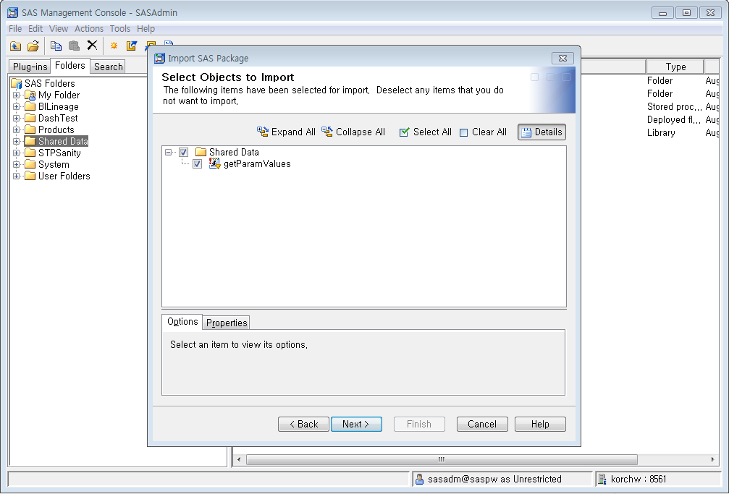
2.INSTALLATION
Import ‘getParamValues.spk’
1. Check ‘getParamValues’
6. Check object to import
2. Click ‘Next’

Slide 16
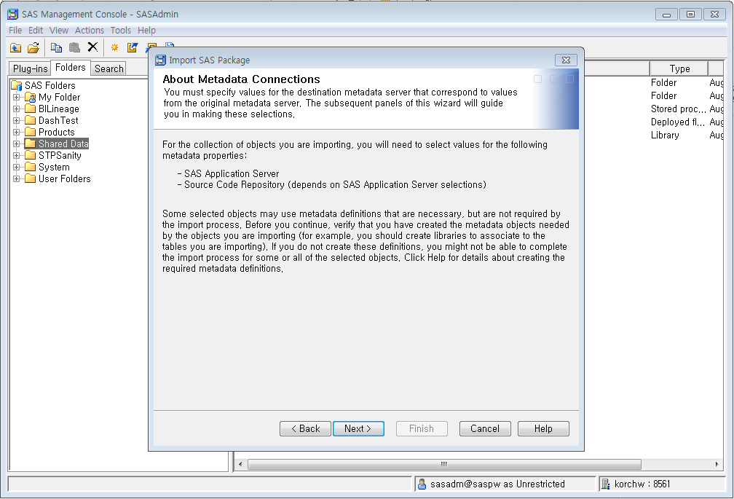
2.INSTALLATION
Import ‘getParamValues.spk’
7. Click ‘Next’
Click ‘Next’

Slide 17
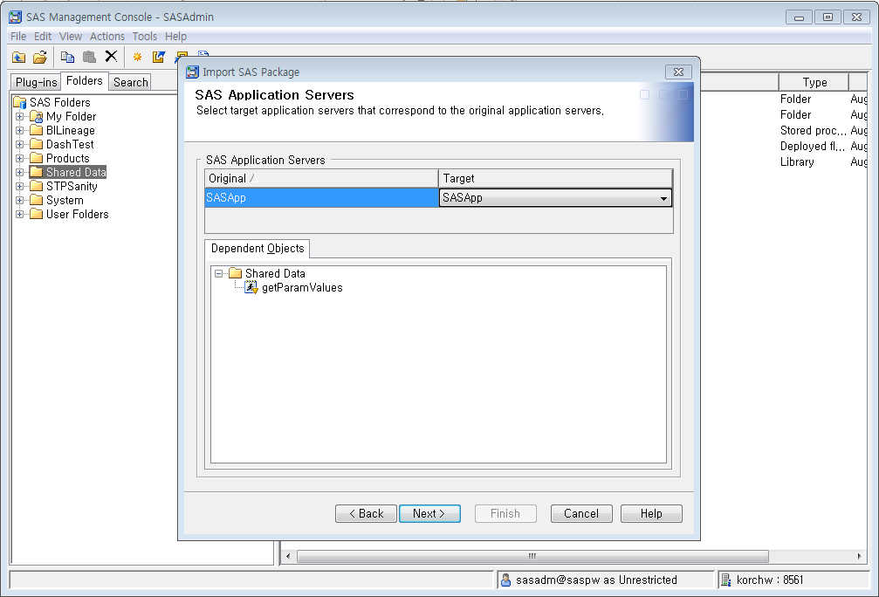
2.INSTALLATION
Import ‘getParamValues.spk’
1. Select ‘SASApp’ server
8. Select ‘SASApp’ Server
2. Click ‘Next’

Slide 18
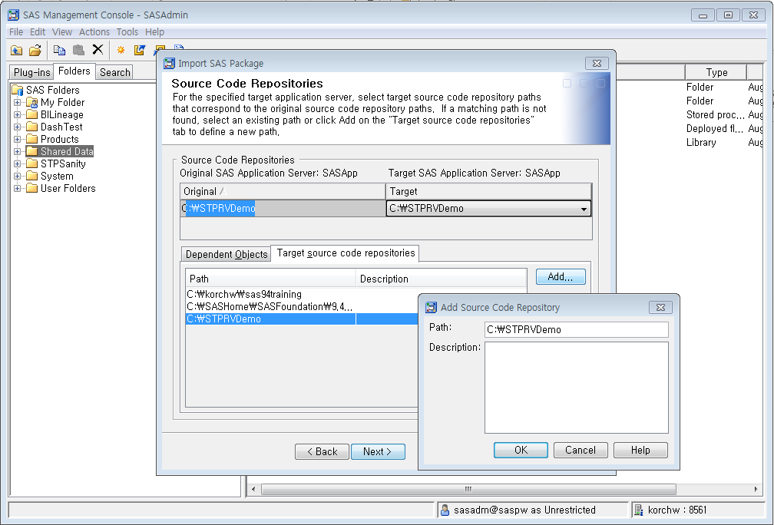
2.INSTALLATION
Import ‘getParamValues.spk’
4. Select ‘C:\STPRVDemo’
1. Click ‘Add’ button
9. Select Source Code Repositories
2. Type ‘C:\STPRVDemo’
5. Click ‘Next’
3. Click ‘OK’

Slide 19
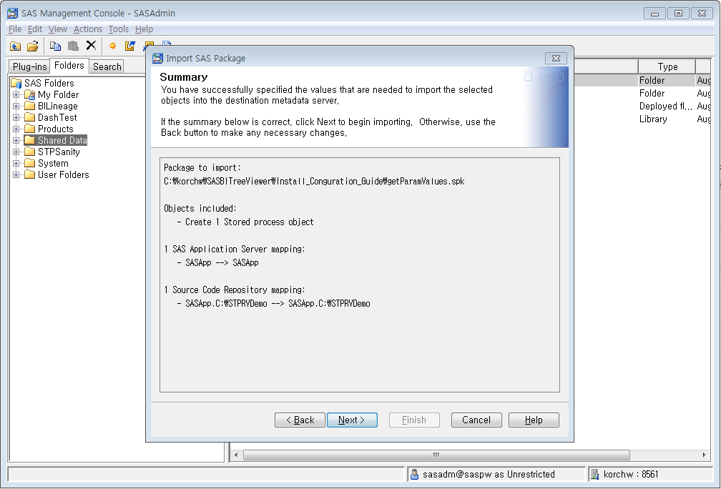
2.INSTALLATION
Import ‘getParamValues.spk’
10. Check Summary
Click ‘Next’

Slide 20
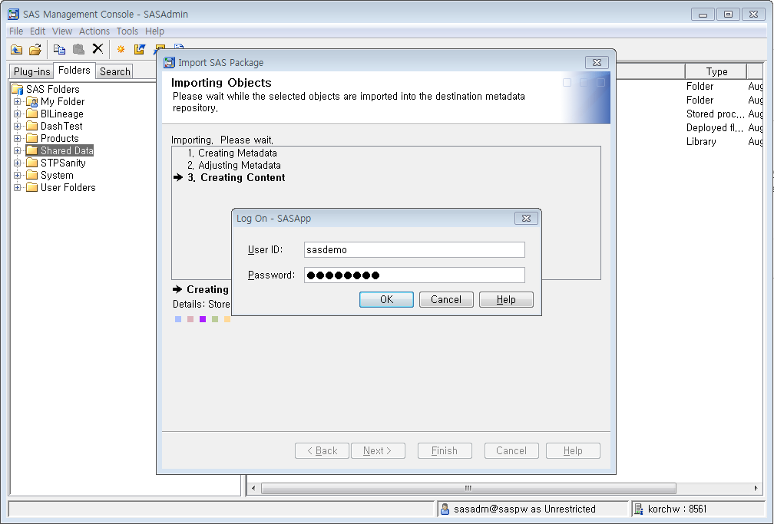
2.INSTALLATION
Import ‘getParamValues.spk’
1. Input ‘SASdemo’ id and password
11. Input SASApp Log on credential
2. Click ‘Next’

Slide 21
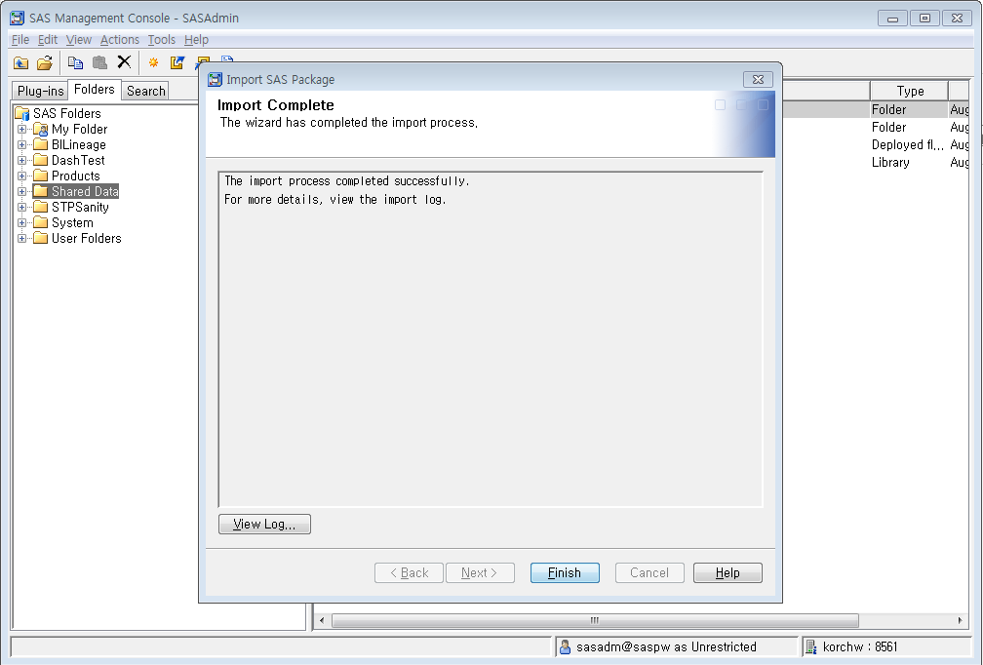
2.INSTALLATION
Import ‘getParamValues.spk’
12. Import complete
Click ‘Finish’

Slide 22
2.INSTALLATION
Add 3 par file
Add ‘SASBITreeViewer94.par’, ‘VAViewerPortlet.par’ and ‘SASSingleSTPPortlet.par’ to ‘C:\SAS\Config\Lev1\Web\Applications\SASPortlets4.4\Deployed\’

Slide 23
2.INSTALLATION
Add SASBITreeViewerA folder
Add ‘SASBITreeViewerA’ folder to ‘C:\SAS\Config\Lev1\Web\WebServer\htdocs\’

Slide 24
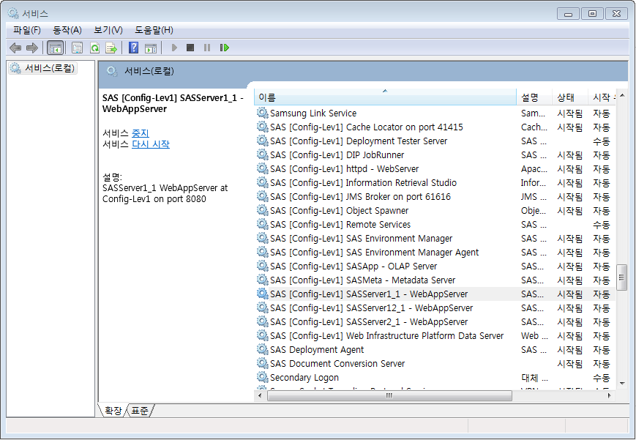
2.INSTALLATION
Restart server
Restart ‘SAS[Config-Lev1]httpd-WebServer’ and ‘SAS [Config-Lev1] SASServer1_1 - WebAppServer’

Slide 25
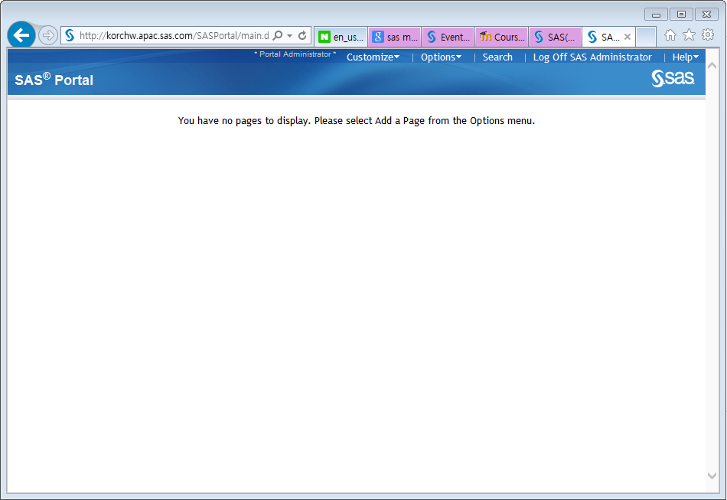
2.INSTALLATION
Validation
Open Web Browser such as IE or Chrome
Log in ‘sasadm@saspw’ account

Slide 26
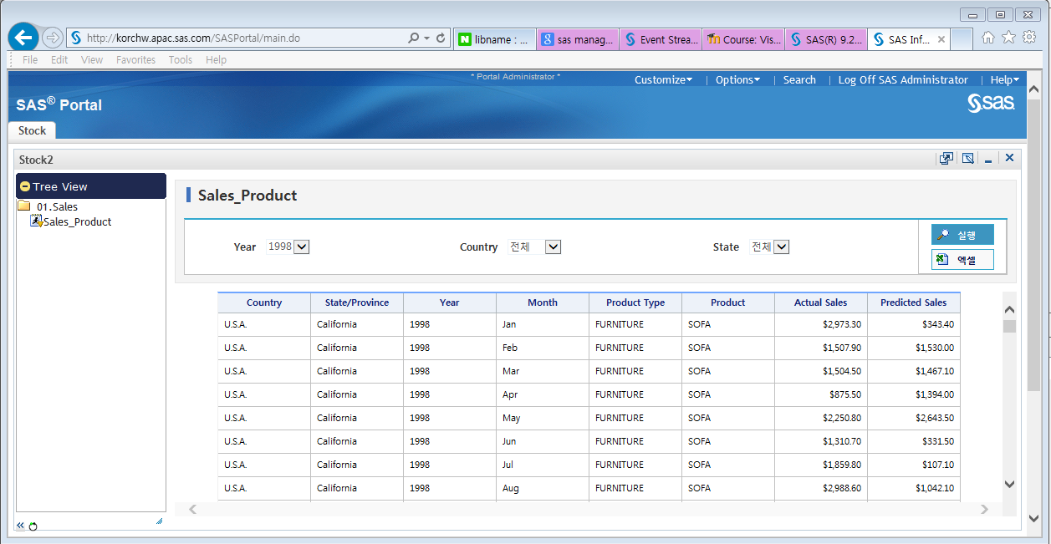
3.Create report
Scenario
Scenario
Clients want to see sales data by year, country, and state.
Data
SAShelp.prdsal2
Search condition(Prompts)
Year, Country, State
Output(Result)
country, state, year, month, prodtype, product, actual, predict

Slide 27
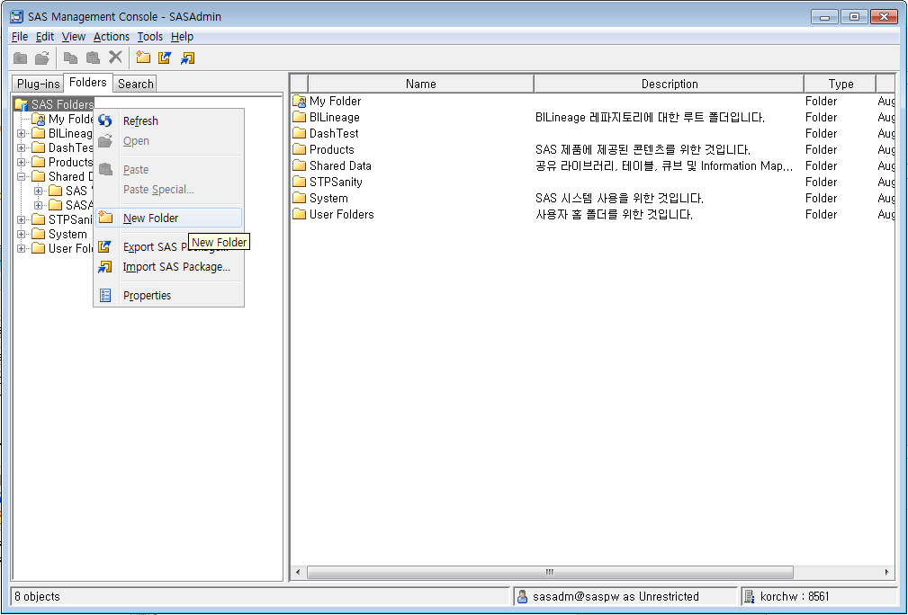
3.Create report
Data preparation
Log in SAS Management Console
Go to ‘Folders’ tab.
Right mouse click ‘SAS Folders’.
Click ‘New Folder’
Click ‘New Folder’

Slide 28
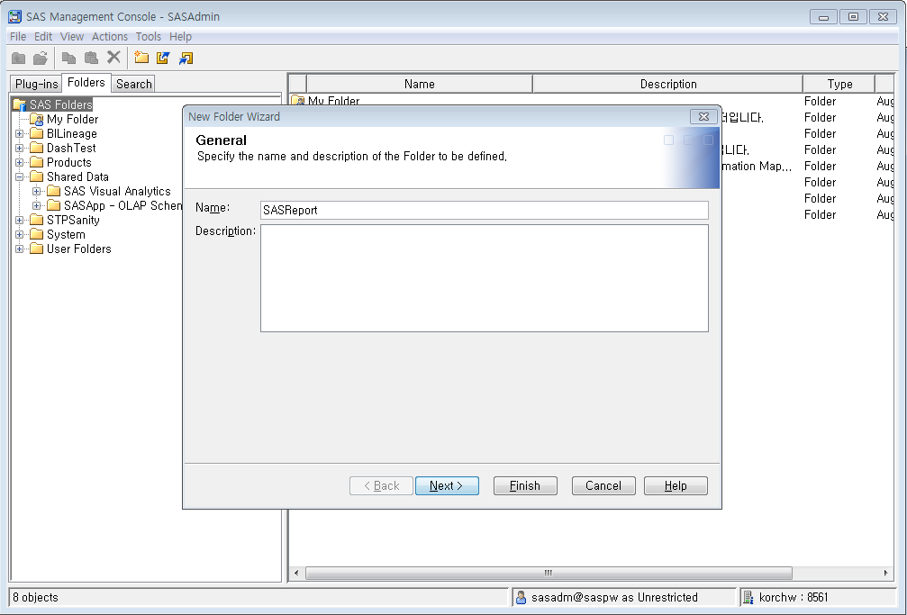
3.Create report
Data preparation
Input Folder name
1. Type ‘SASReport’
2. Click ‘Next’

Slide 29
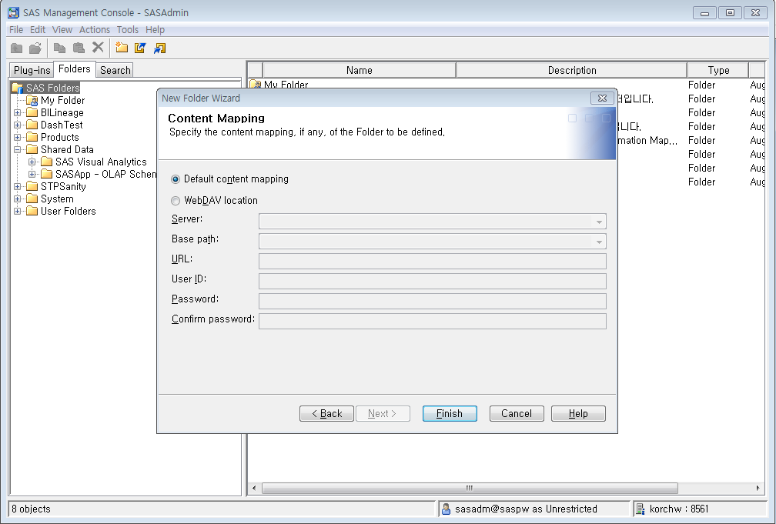
3.Create report
Data preparation
Click ‘Finish’
Click ‘Finish’

Slide 30
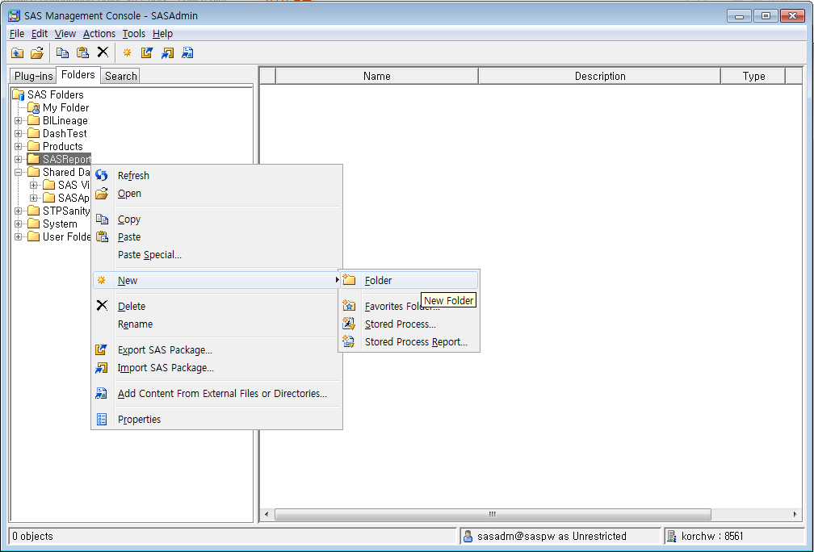
3.Create report
Data preparation
Click ‘Folder’
Right mouse click ‘SASReport’.
Click ‘New’ -> ‘Folder’

Slide 31
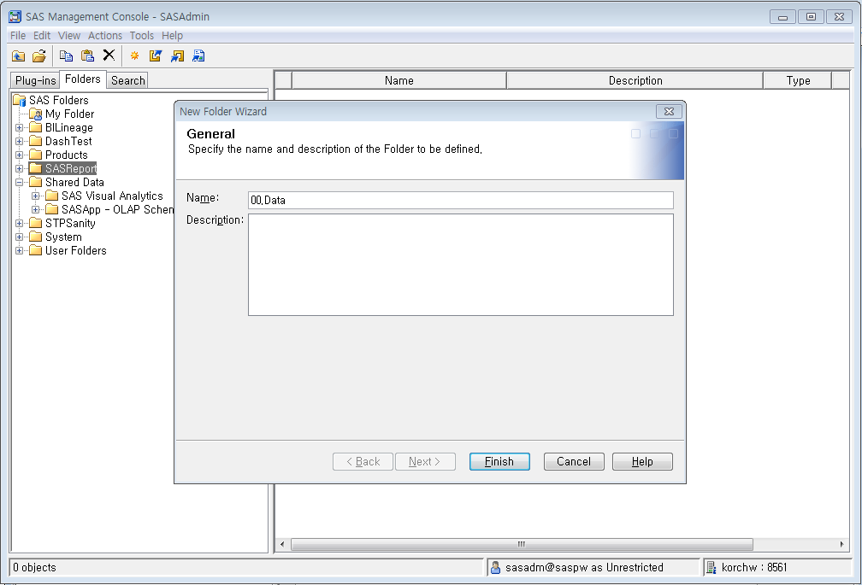
3.Create report
Data preparation
1. Type ’00.Data’
Input Folder name
2. Click ‘Finish’

Slide 32
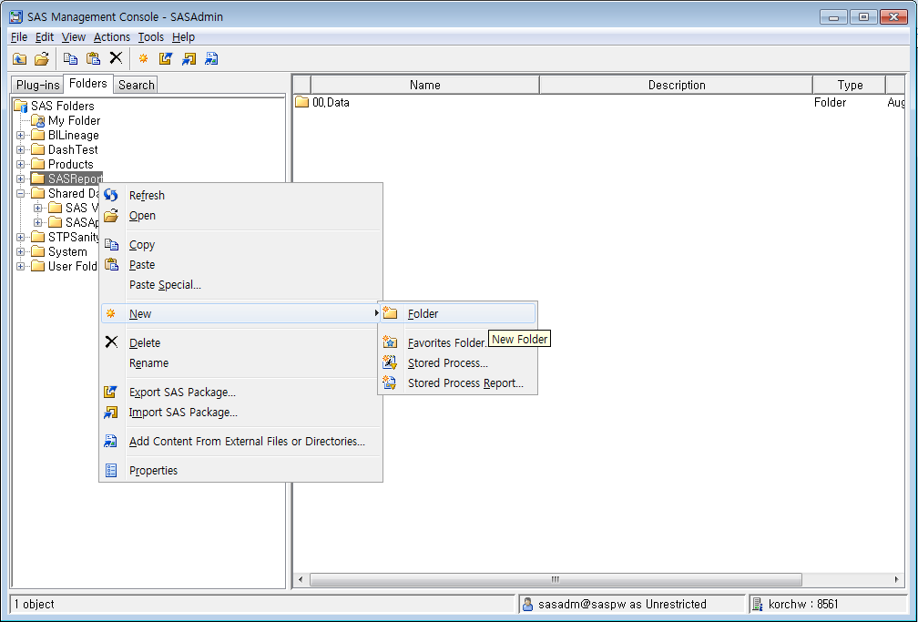
3.Create report
Data preparation
Click ‘Folder’
Right mouse click ‘SASReport’.
Click ‘New’ -> ‘Folder’

Slide 33
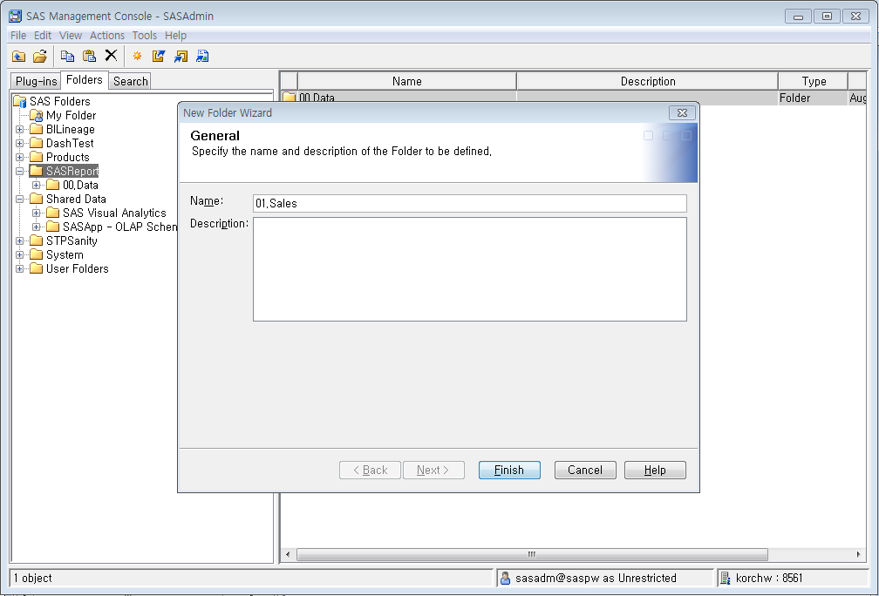
3.Create report
Data preparation
1. Type 01.Sales’
Input folder name
2. Click ‘Finish’

Slide 34
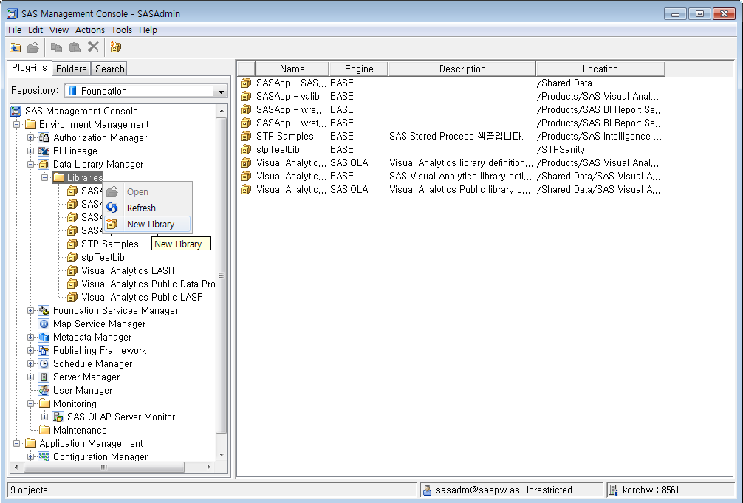
3.Create report
Data preparation
Go to ‘Plug-ins’ tab
Navigate to ‘SAS Management Console’ -> ‘Environment Management’ -> Data Library Manager’
Right mouse click ‘Libraries’
Click ‘New Library’
Click ‘New Library’

Slide 35
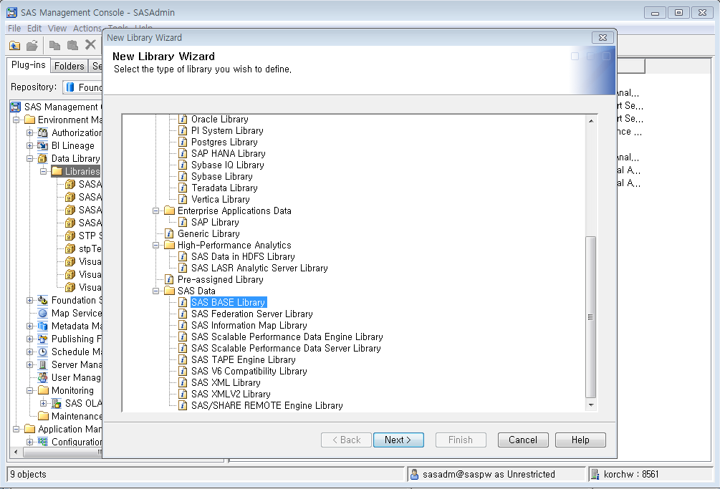
3.Create report
Data preparation
1. Select ‘SAS BASE Library’
Select ‘SAS BASE Library’
2.Click ‘Next’

Slide 36
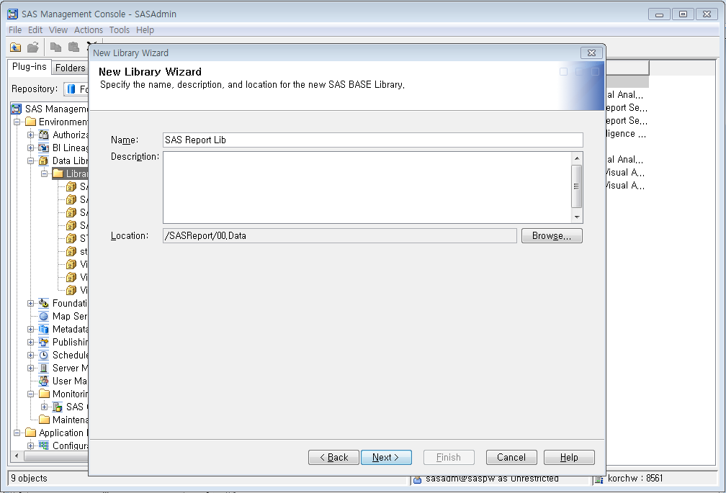
3.Create report
Data preparation
1. Type ‘SAS Report Lib’
Input library name and select location
2. Click ‘Browse’ and select ‘/SASReport/00.Data
3. Click ‘Next’

Slide 37
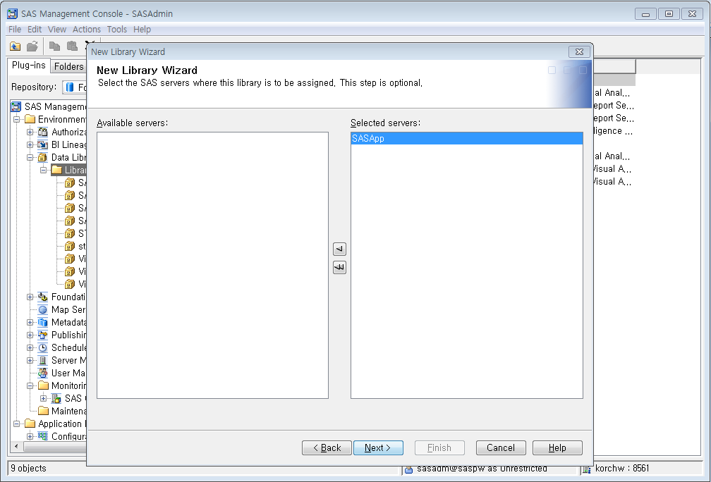
3.Create report
Data preparation
1. Select ‘SASApp’
Select SAS server
2. Click ‘Next’

Slide 38
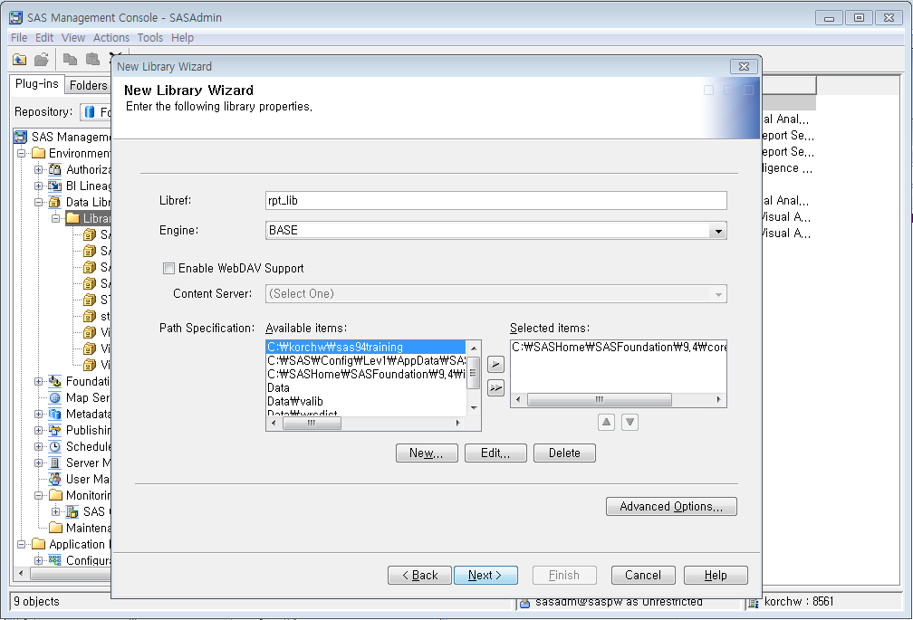
3.Create report
Data preparation
1. Type ’rpt_lib’
3. Select ‘C:\SASHome\SASFoundation\9.4\core\SAShelp’
Input Libref
Select physical library path
4. Click ‘Next’
2. Click ‘New’ and select ‘C:\SASHome\SASFoundation\9.4\core\SAShelp’

Slide 39
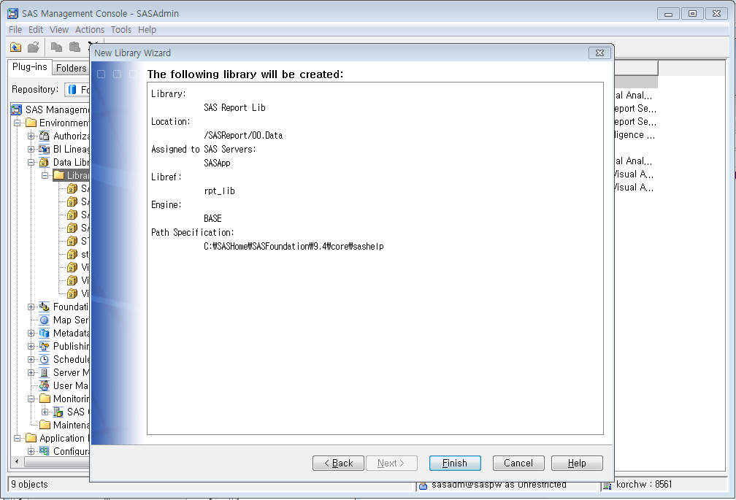
3.Create report
Data preparation
Check information
4. Click ‘Finish’

Slide 40
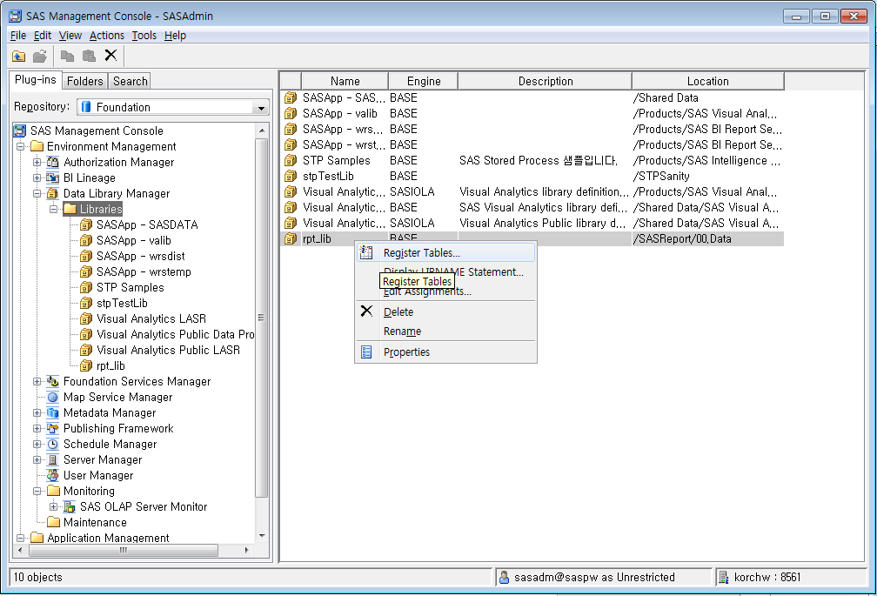
3.Create report
Data preparation
Right mouse click ‘rpt_lib’
Click ‘Register Tables’
Click ‘Register Tables’

Slide 41
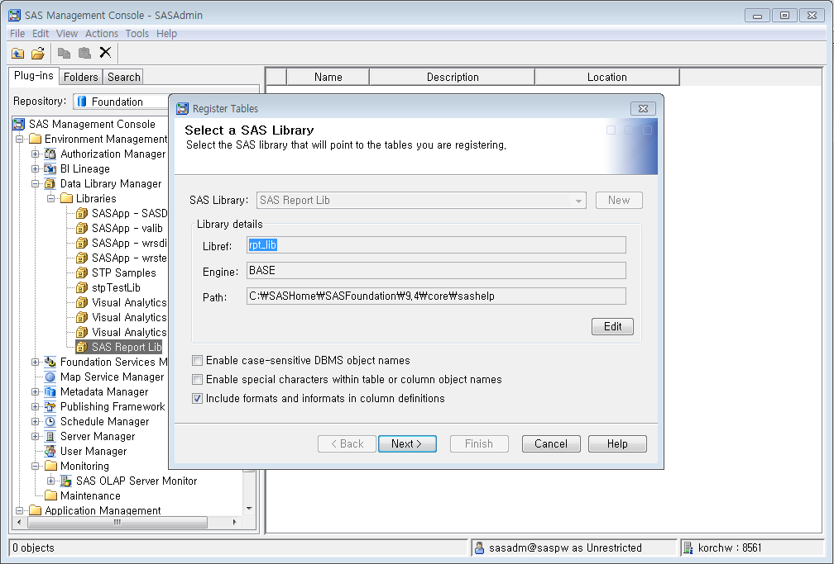
3.Create report
Data preparation
Click ‘Next’
Click ‘Next’

Slide 42
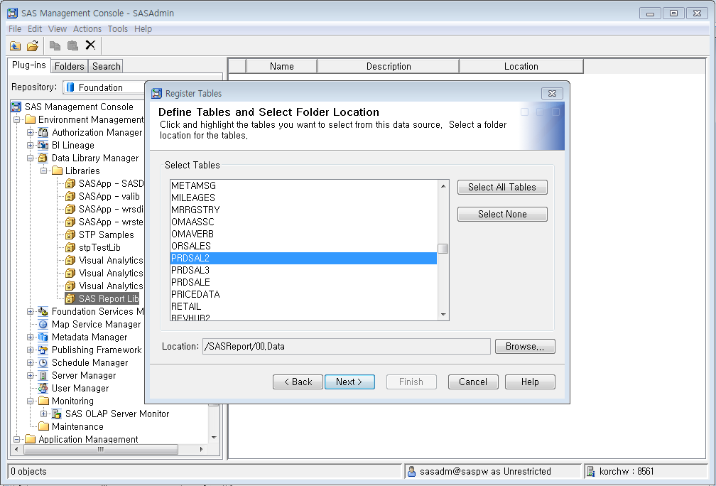
3.Create report
Data preparation
1. Select ‘PRDSAL2’
Select tables that you want to register and select location for that
2. Click ‘Browse’ then select ‘/SASReport/00.Data’
3. Click ‘Next’

Slide 43
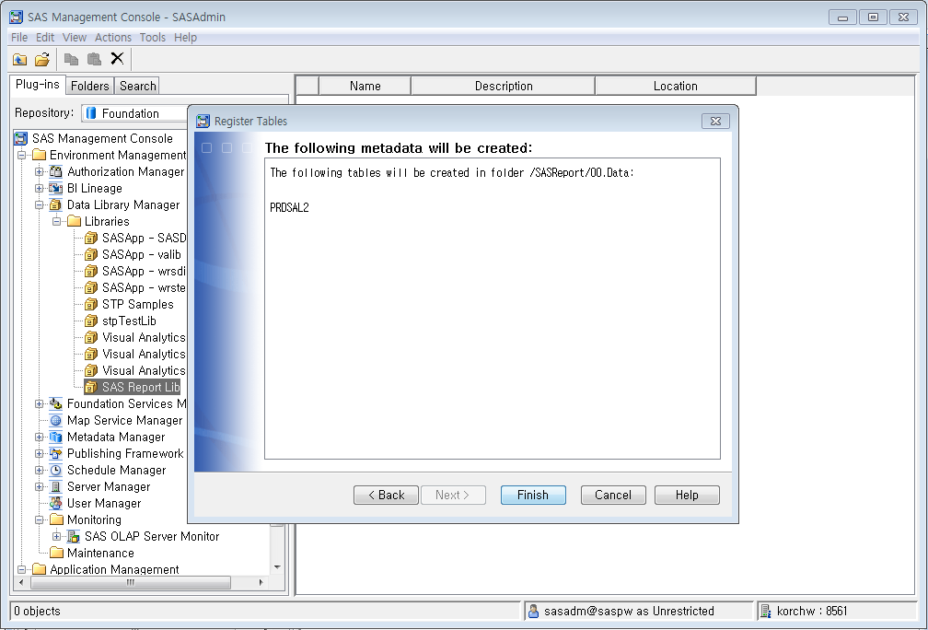
3.Create report
Data preparation
Check information
3. Click ‘Next’

Slide 44
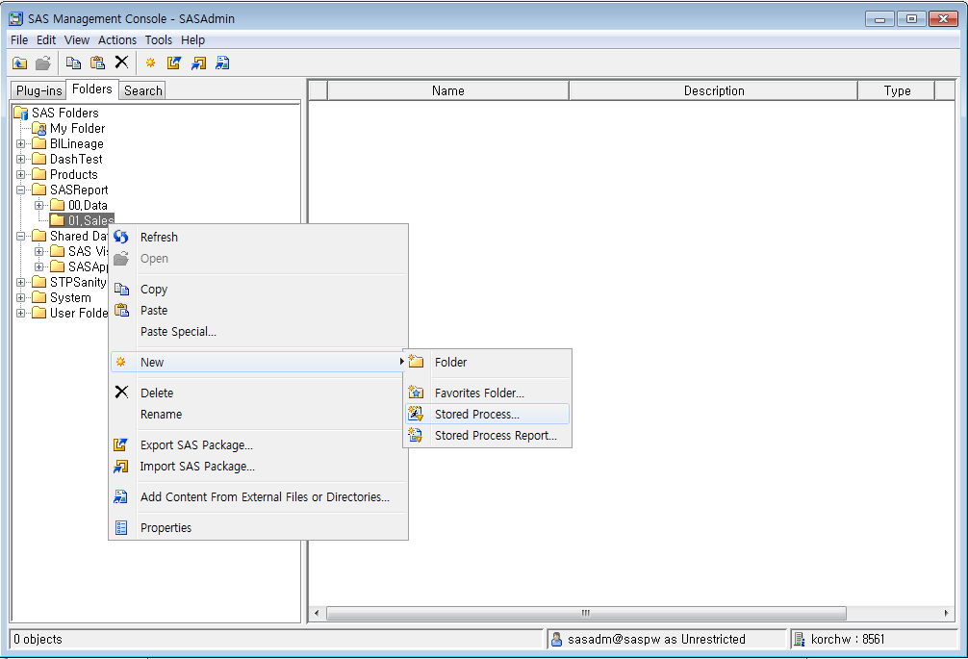
3.Create report
Create stored process
Go to ‘Folders’ tab
Navigate to ‘SAS Folders’ -> ‘SASReport’
Right mouse click ‘01.Sales’
Click ‘New’ -> ‘Stored Process’
Click ‘Stored Process’

Slide 45
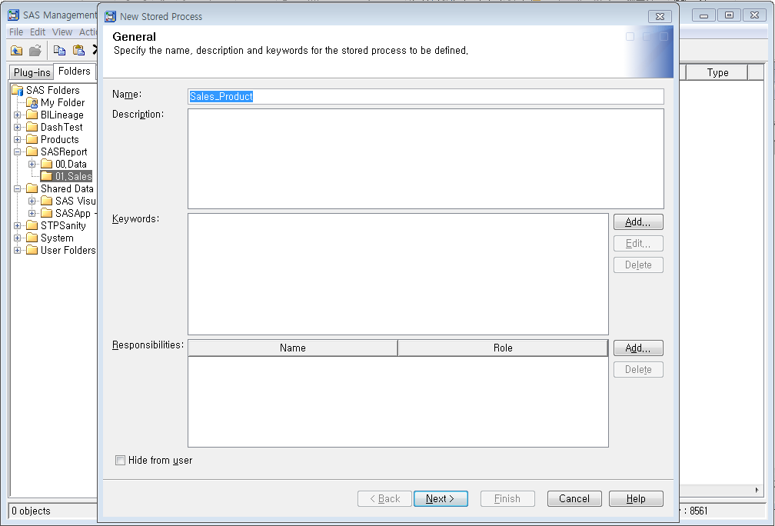
3.Create report
Create stored process
1. Type ‘Sales_Product’
Input STP name
2. Click ‘Next’

Slide 46
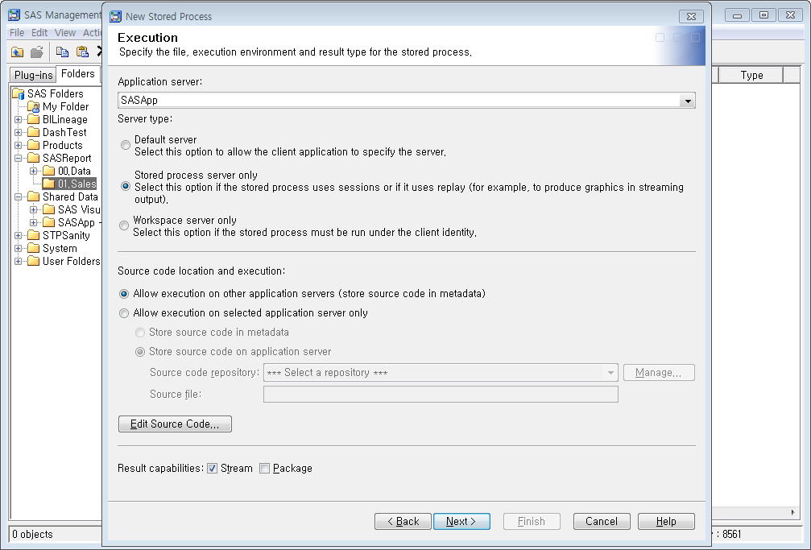
3.Create report
Create stored process
1. Select ‘SASApp’
2. Select ‘Stored process server only’
Select application server
Select server that stored process will be run
Choose to store source codes in metadata or physical drive
3. Select ‘store source code in metadata’
4. Click ‘Edit Source Code’

Slide 47
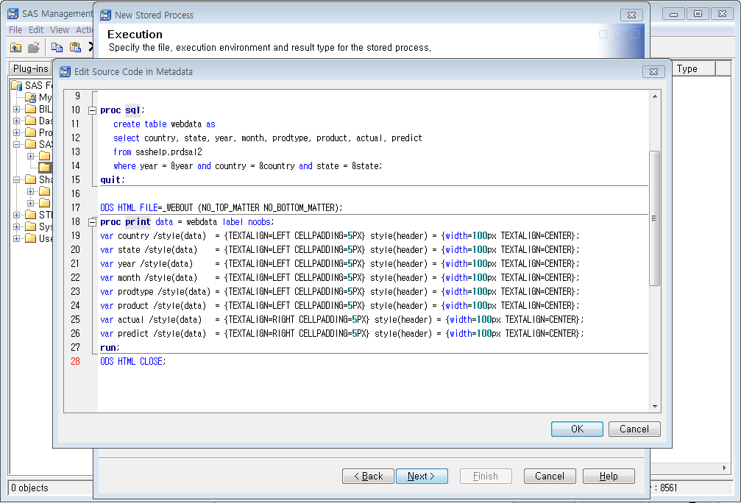
3.Create report
Create stored process
1. Edit source code
Edit source code
* Full source codes are on the notes
2. Click ‘OK’
Notes:
data _null_;
if "&country" eq '' then do; call symput('country', 'country'); end;
else do; call symput('country', "%str(%')&country%str(%')"); end;
if "&state" eq '' then do; call symput('state', 'state'); end;
else do; call symput('state', "%str(%')&state%str(%')"); end;
run;
%put country: &country;
proc sql;
create table webdata as
select country, state, year, month, prodtype, product, actual, predict
from SAShelp.prdsal2
where year = &year and country = &country and state = &state;
quit;
ODS HTML FILE=_WEBOUT (NO_TOP_MATTER NO_BOTTOM_MATTER);
proc print data = webdata label noobs;
var country /style(data) = {TEXTALIGN=LEFT CELLPADDING=5PX} style(header) = {width=100px TEXTALIGN=CENTER};
var state /style(data) = {TEXTALIGN=LEFT CELLPADDING=5PX} style(header) = {width=100px TEXTALIGN=CENTER};
var year /style(data) = {TEXTALIGN=LEFT CELLPADDING=5PX} style(header) = {width=100px TEXTALIGN=CENTER};
var month /style(data) = {TEXTALIGN=LEFT CELLPADDING=5PX} style(header) = {width=100px TEXTALIGN=CENTER};
var prodtype /style(data) = {TEXTALIGN=LEFT CELLPADDING=5PX} style(header) = {width=100px TEXTALIGN=CENTER};
var product /style(data) = {TEXTALIGN=LEFT CELLPADDING=5PX} style(header) = {width=100px TEXTALIGN=CENTER};
var actual /style(data) = {TEXTALIGN=RIGHT CELLPADDING=5PX} style(header) = {width=100px TEXTALIGN=CENTER};
var predict /style(data) = {TEXTALIGN=RIGHT CELLPADDING=5PX} style(header) = {width=100px TEXTALIGN=CENTER};
run;
ODS HTML CLOSE;

Slide 48

3.Create report
Create stored process
Select result capabilities
1. Click ‘Stream’ Check Box
2. Click ‘Next’

Slide 49
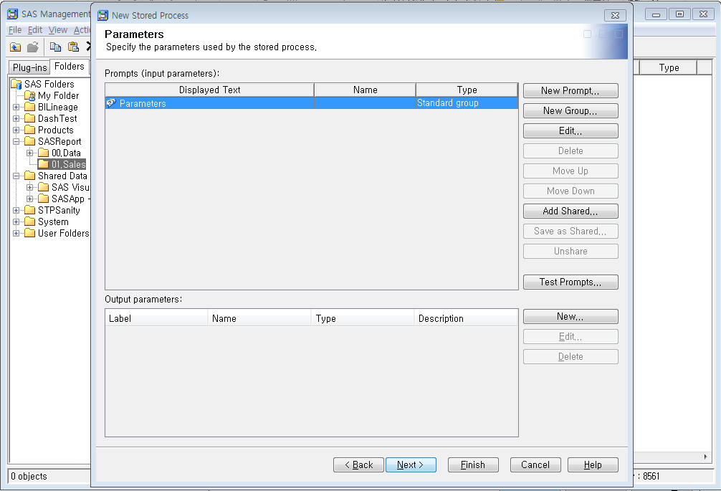
3.Create report
Create stored process
Create new prompt
In this scenario, I will create 3 types of prompt.
Year: ‘User selects values from a static list’
Country: ‘user selects values from a dynamic list’
State: State prompt has dependency with Country. State prompt values will be changed Country accordingly
This Document will not cover how to create prompts in detail. Please refer to the ‘SAS(R) 9.4 Stored Processes: Developer's Guide’
Click ‘New Prompt’

Slide 50
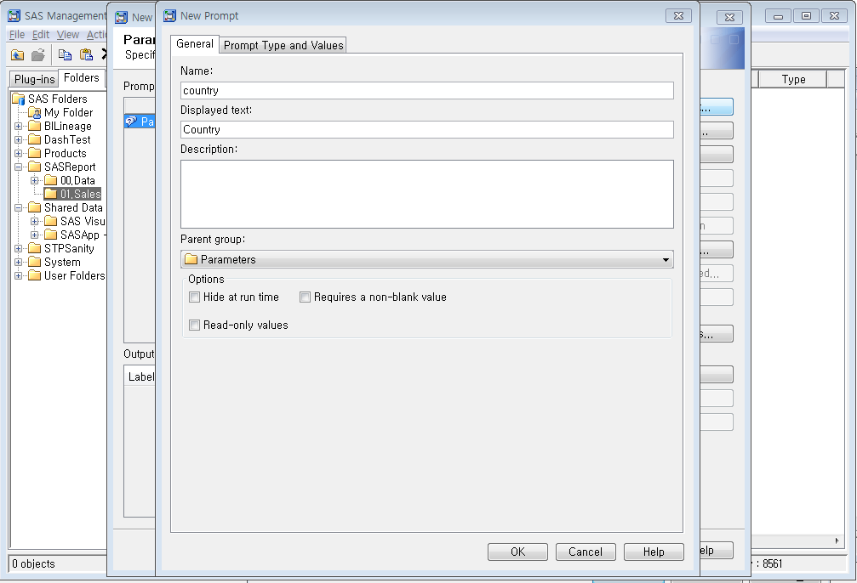
3.Create report
Create stored process
1. Type ‘country’
2. Type ‘Country’
3. Click ‘Prompt Type and Values’ tab
Input prompt name

Slide 51
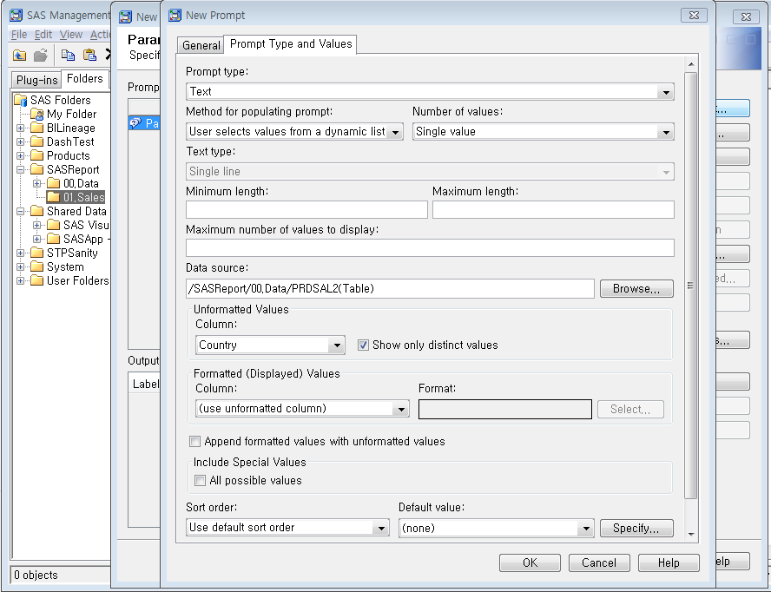
3.Create report
Create stored process
1. Select ‘User selects values from a dynamic list’
2. Click ‘Browse’ and select ‘/SASReport/00.data/PRDSAL2(Table)’
Input prompt type and values
3. Select ‘Country’
4. Click ‘OK’

Slide 52

3.Create report
Create stored process
Click ‘New Prompt’
Create new prompt

Slide 53
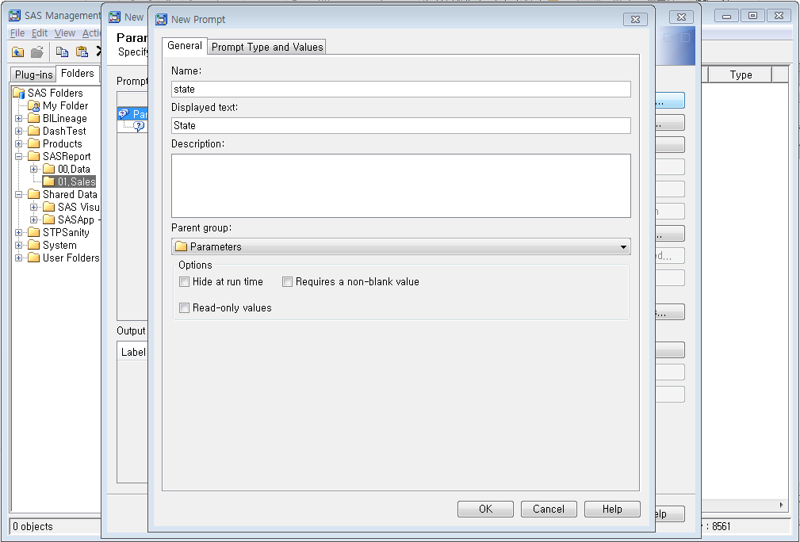
3.Create report
Create stored process
1. Type ‘state’
2. Type ’State’
3. Click ‘Prompt Type and Values’ tab
Input prompt name

Slide 54
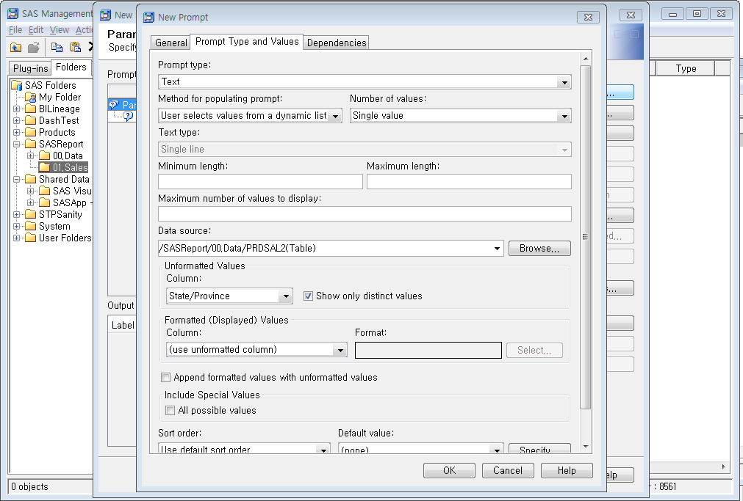
3.Create report
Create stored process
1. Select ‘User selects values from a dynamic list’
2. Click ‘Browse’ and select ‘/SASReport/00.data/PRDSAL2(Table)’
Input prompt type and values
3. Select ‘State/Province’
4. Click ‘Dependencies’ tab

Slide 55
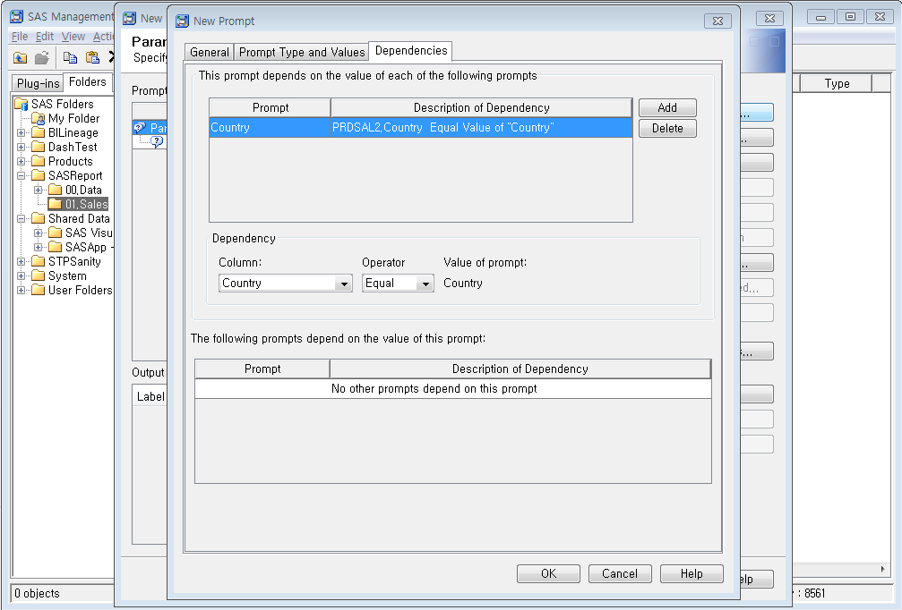
3.Create report
Create stored process
1. Click ‘Add’
2. Select ‘Country’
3. Select ‘Equal’
Input dependencies information
4. Click ‘OK’

Slide 56
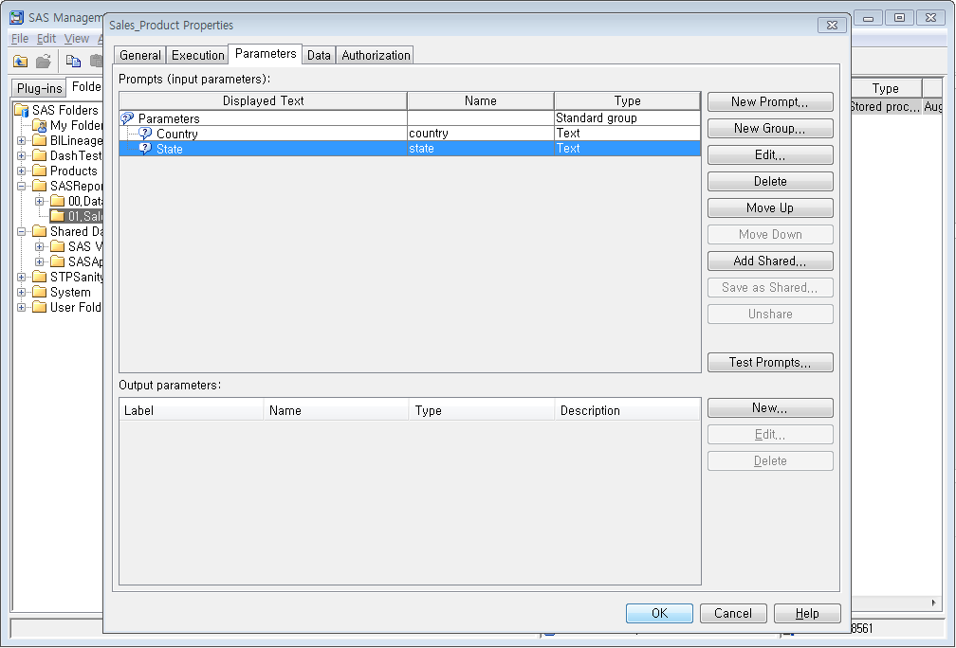
3.Create report
Create stored process
Click ‘New Prompt’
Create new prompt

Slide 57
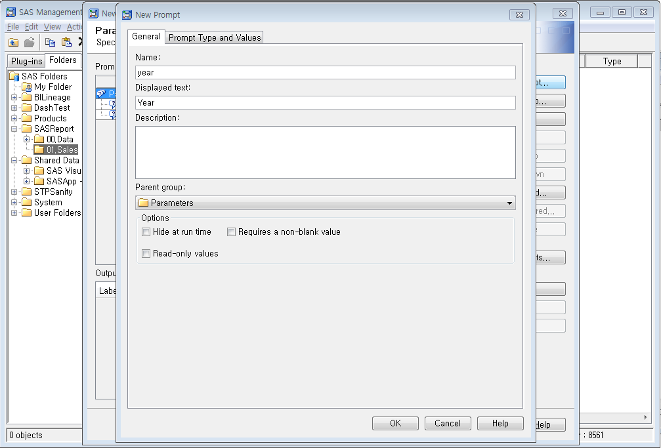
3.Create report
Create stored process
1. Type ‘year’
2. Type ‘Year’
3. Click ‘Prompt Type and Values’ tab
Input prompt name

Slide 58
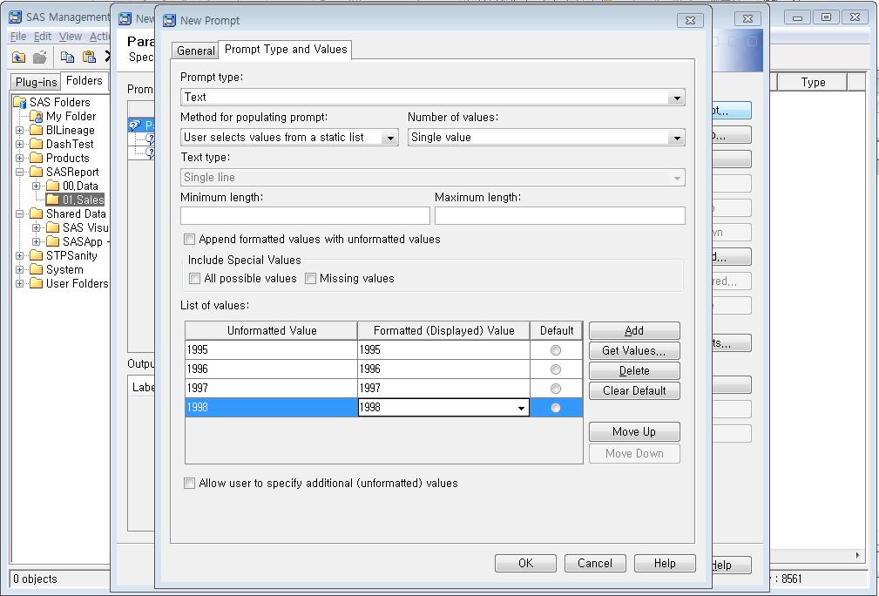
3.Create report
Create stored process
1. Select ‘User selects values from a static list’
2. Type ‘1995’, ‘1996’, ‘1997’, ‘1998’
Input prompt type and values
3. Click ‘OK’

Slide 59
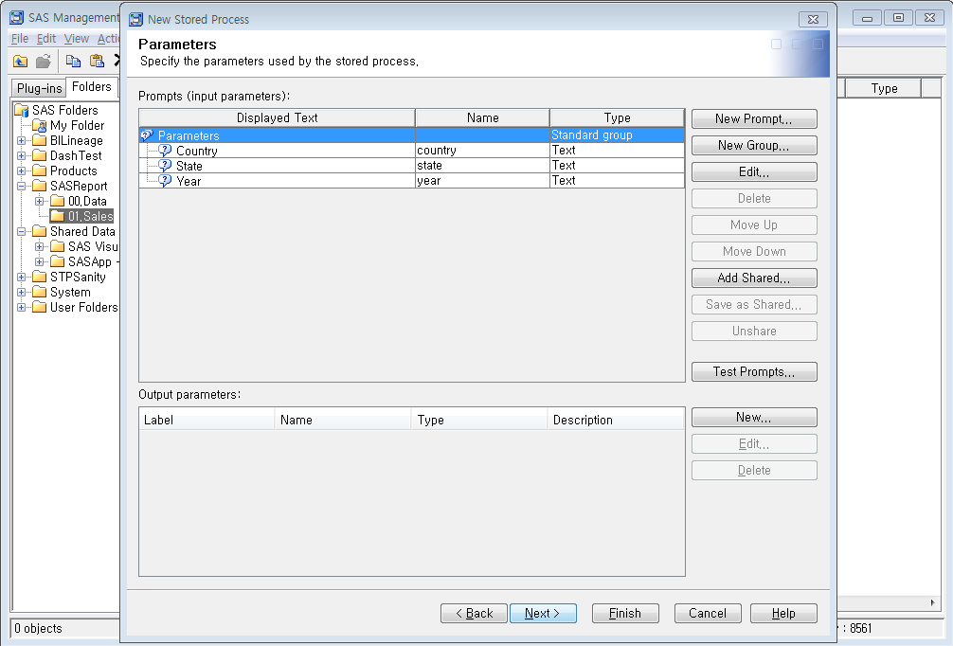
3.Create report
Create stored process
Finished to create prompts
Click ‘Next’
3. Click ‘Next’

Slide 60
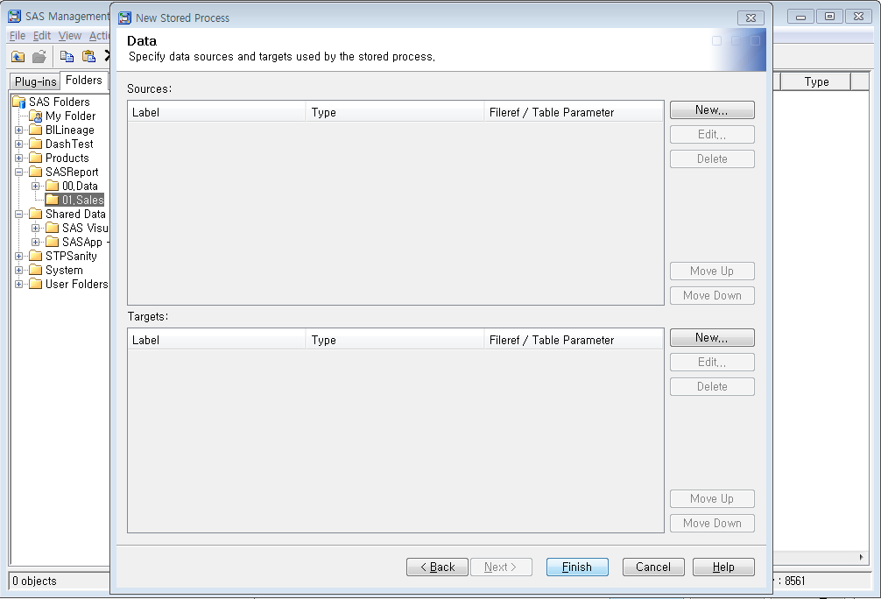
3.Create report
Create stored process
Stored process has been created.
3. Click ‘Finish’

Slide 61
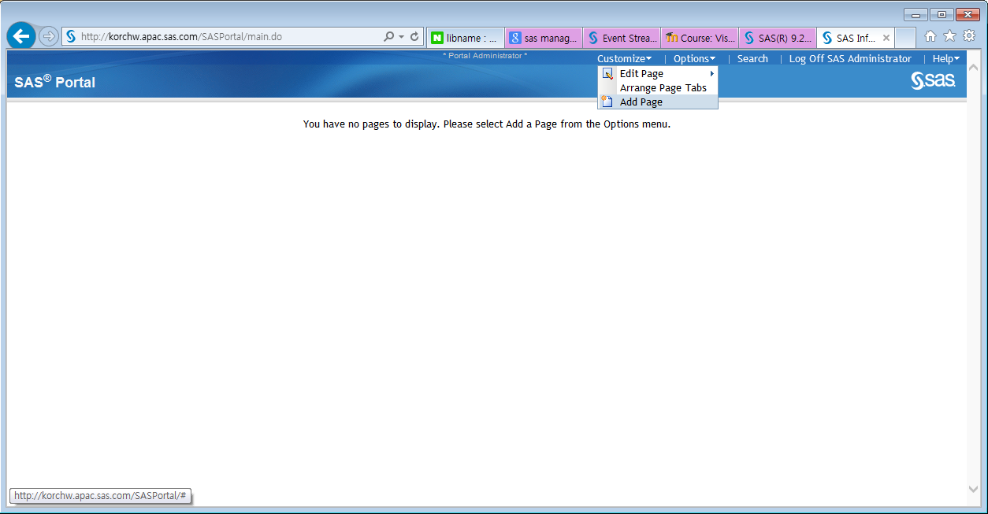
3.Create report
Create SAS portal page
3. Click ‘Add Page’
Create SAS Portal page

Slide 62

3.Create report
Create SAS portal page
1. Type ‘Sales’
Input page name
2. Click ‘Add’

Slide 63

3.Create report
Create SAS portal page
Finished to create page
Click ‘Done’

Slide 64

3.Create report
Create SAS portal page
You will see newly created portal page

Slide 65

3.Create report
Create SAS portal page
Click ‘Edit Page Content’
Add portlet to page

Slide 66

3.Create report
Create SAS portal page
Create new portlet
Click ‘Add Portlets’

Slide 67

3.Create report
Create SAS portal page
1. Select ‘SASBITreeViewer94’
2. Type ‘SalesReport’
Create ‘SASBITreeViewer94’ type portlet
3. Click ‘Add’
4. Click ‘Done’

Slide 68

3.Create report
Create SAS portal page
Finished to create portlet
Click ‘OK’

Slide 69

3.Create report
Create SAS portal page
Click ‘Edit Content’ button
Edit ‘SASBITreeViewer94’ Portlet

Slide 70

3.Create report
Create SAS portal page
Select location that stored process exist
1. Select ‘SASReport’
3. Click ‘Save changes’ at the bottom of this page
2. Select ’01.Sales’

Slide 71

3.Create report
Create SAS portal page
1. Click ‘Sales_Product’
2. Select search criteria as you want
3. Click ‘Execute’ button
Finally you will see the typical report that is based on ‘SASBITreeViewer94’
Results

Slide 72
4.Contact info.
.
Please contact young-ho.hwang@sas.com if you have any question.

Slide 73
End of Document

